Slide 1
Servlets

Slide 2
Introduction
Servlets are small programs that execute on the server side of a web connection
Just as applets dynamically extend the functionality of a web browser, servlets dynamically extend the functionality of a web server

Slide 3
Web Browser and Server cooperation
Example: request for a static web page
A USER enters a Uniform Resource Locator (URL) into a browser.
The BROWSER generates an HTTP request to the appropriate web server.
The WEB SERVER maps this request to a specific file. That file is returned in an HTTP response to the browser.

Slide 4
Web Browser and Server cooperation cont…
The HTTP header in the response indicates the type of the content. The Multipurpose Internet Mail Extensions (MIME) are used for this purpose.
For example, ordinary ASCII text has a MIME type of text/plain.
The Hypertext Markup Language (HTML) source code of a webpage has a MIME type of text/html.

Slide 5
Web Browser and Server cooperation cont…
Example: Dynamic content
early days of the Web, a server could dynamically construct a page by creating a separate process to handle each client request.
The process would open connections to one or more databases in order to obtain the necessary information. It communicated with the web server via an interface known as the Common Gateway Interface (CGI).
CGI allowed the separate process to read data from the HTTP request and write data to the HTTP response.
A variety of different languages were used to build CGI programs. These included C, C++, and Perl.

Slide 6
Web Browser and Server cooperation cont…
CGI suffered serious performance problems.
It was expensive in terms of processor and memory resources to create a separate process for each client request
It was also expensive to open and close database connections for each client request.
the CGI programs were not platform-independent.

Slide 7
Advantages of Servlets
First, performance is significantly better.
Servlets execute within the address space of a web server.
Second, servlets are platform-independent
Third, the Java security manager on the server enforces a set of restrictions to protect the resources on a server machine.
Finally, the full functionality of the Java class libraries is available to a servlet. It can communicate with applets, databases, or other software via the sockets and RMI mechanisms

Slide 8
The Life Cycle of a Servlet
Three methods :
init( )
service( )
destroy( )
They are implemented by every servlet and are invoked at specific times by the server.
First, assume that a user enters a Uniform Resource Locator (URL) to a Web browser.
The browser then generates an HTTP request for this URL and sends it to the appropriate server.

Slide 9
Second, this HTTP request is received by the Web server. The server maps this request to a particular servlet. The servlet is dynamically retrieved and loaded into the address space of the server.
Third, the server invokes the init( ) method of the servlet. This method is invoked only when the servlet is first loaded into memory.
Fourth, the server invokes the servlet's service( ) method, which is called to process the HTTP request. The servlet can read data that has been provided in the HTTP request, and may also formulate an HTTP response for the client

Slide 10
The servlet remains in the server's address space and is available to process any other HTTP requests received from clients. The service( ) method is called for each HTTP request.
Finally, the server may decide to unload the servlet from its memory. It calls the destroy() method to relinquish any resources, such as file handles that are allocated for the servlet. Important data may be saved to a persistent store. The memory allocated for the servlet and its objects can then be garbage-collected.

Slide 11
Servlet API
Two packages contain the classes and interfaces that are required to build servlets. These are javax.servlet and javax.servlet.http.

Slide 12
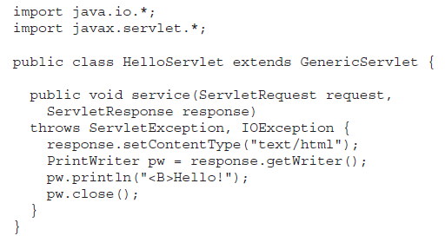

Slide 13
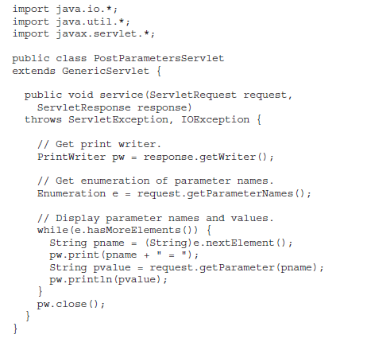

Slide 14
Cookies
The Cookie class encapsulates a cookie.
A cookie is stored on a client and contains state information.
Cookies are valuable for tracking user activities.

Slide 15
Adding a cookie
A servlet can write a cookie to a user’s machine via the addCookie( ) method of the HttpServletResponse interface
The data for that cookie is then included in the header of the HTTP response that is sent to the browser

Slide 16
Adding a cookie
The names and values of cookies are stored on the user’s machine. Some of the info added
The name of the cookie
The value of the cookie
The expiration date of the cookie
The domain and path of the cookie
There is one constructor for Cookie. It has the signature shown here:
Cookie(String name, String value)

Slide 17
The domain and path of the cookie determine when it is included in the header of an HTTP request.
If the user enters a URL whose domain and path match these values, the cookie is then supplied to the Web server. Otherwise, it is not.

Slide 18
Session Tracking
HTTP is a stateless protocol. Each request is independent of the previous one.
Sometimes it is needed to save state information like online shopping
A session can be created via the getSession() method of HttpServletRequest.
An HttpSession object is returned

Slide 19
Session Tracking
This object can store a set of bindings that associate names with objects.
The setAttribute( ), getAttribute( ), getAttributeNames( ), and removeAttribute( ) methods of HttpSession manage these bindings.
session state is shared among all the servlets that are associated with a particular client

Slide 20
Session Tracking
This object can store a set of bindings that associate names with objects.
The setAttribute( ), getAttribute( ), getAttributeNames( ), and removeAttribute( ) methods of HttpSession manage these bindings.
session state is shared among all the servlets that are associated with a particular client

